Slide 1
Intro to CSS (and Responsive Design) Please sign in: http://tinyurl.com/h7d5p2g
MAD Spring 2016
Brian Cui

Slide 2
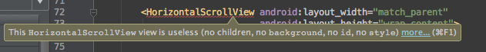
*Not actually HTML
**But close enough

Slide 3

Your Mission
The owners of CAT PICTURE CENTRAL wants you to fix up their website. They'll pay you a box of kittens if you can meet the following requirements:
There should be no inline CSS on the page.
The font should be sans serif everywhere.
All cat pictures should be centered on their own line.
The navigation "bar" should be on a single line on desktop.
The website should look good on mobile.
Download the website code here: https://github.com/utcsmad/s16-web

Slide 4

HTML Crash Course: Syntax
HTML is a markup language. It describes content with an (infinite) tree-like hierarchy of parents and children.
<p>This is a paragraph!</p>
<ul> <li>A Child 1</li> <li>Child two</li> <li>Adopted Child three</li> </ul>
Advanced: HTML5 actually offers (will offer) a JavaScript interface for creating custom elements. Currently only supported in Chrome.
<ul>
<li>

Slide 5
HTML Crash Course: Attributes
Each HTML tag (there are many!) has a specific meaning.
<h1>BIG HEADER</h1>
<b>This text is bold!</b>
We can assign attributes to HTML elements by defining values within their tags.
<img src="https://i.imgur.com/hfIpqOL.jpg" />
<input type="text" placeholder="Credit Card" />
<a href="http://i.imgur.com/GfzFuy3.gif" />
Advanced: Most element attributes are directly accessible by the same name in JavaScript (e.g. document.getElementById("someID").value). There are some exceptions, such as .htmlFor for the for attribute.

Slide 6

HTML Crash Course: Inline Styles
"I don't like the way my links look blue!" -- You
Using the style attribute, we can customize our HTML elements with our own artistic flair.
<a href="http://goo.gl/qn9FuI" style="color: red"> This link has turned to the dark side... </a>
Other useful properties include font-size, font-family, font-weight…
Advanced: Speaking of fonts, we're now able to embed custom fonts into our webpages using @font-face. That means websites are no longer restricted to "web safe" fonts.
<a>

Slide 7
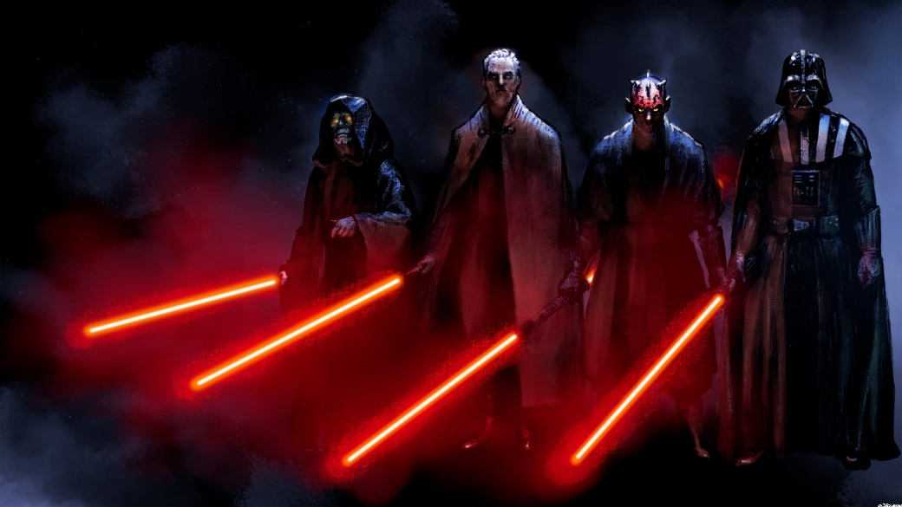
Hello, CSS
CSS is another markup language that complements HTML that applies style properties across multiple elements at once.
a { color: red; }
CSS stands for Cascading Style Sheets. They are sheets in a document sense, they give things style, and they do, in fact, "cascade".
To add a stylesheet to our page, we use the link tag:
<link rel="stylesheet" type="text/css" href="style.css" />
<a>
<a>
<a>
<a>

Slide 8
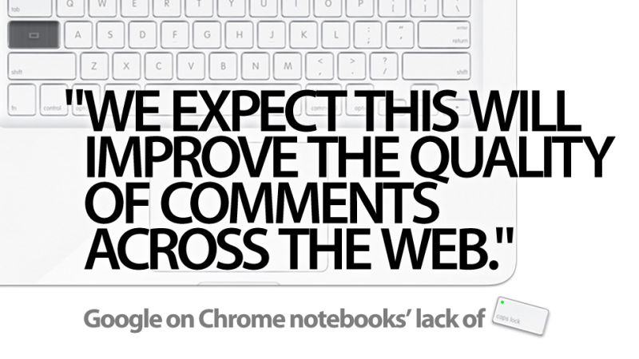
CSS General Syntax
CSS syntax is fairly straightforward:
selector[, selector...] { property: value; ... }
The selector targets a particular set of elements and assigns the property styles to those elements.
The simplest kind of selector is the element type itself:
h1, h2, h3, h4, h5, h6 { text-transform: uppercase; text-decoration: underline; } /* Selects all header tags and makes them allcaps underlined */
Notes:
There are dozens of CSS properties you can use. Your best friend? Google! (and StackOverflow)

Slide 9

Dress Classy
The class attribute groups together elements regardless of type. The . selector targets element of a particular class.
<h1 class="suit">Agents</h1> <p class="suit">James Bond</p> <p class="tie">Austin Powers</p> <p class="suit tie">Elite Beat Agents</p>
.suit { font-style: italic; font-weight: bold; }
Elements can have multiple classes, separated by spaces.
Advanced: The .classList property of HTML elements in JavaScript offers a flexible and effective Object interface for interacting with, well, an element's list of classes. Much easier than .className.

Slide 10

Be Unique
The id attribute uniquely identifies a single element. The # selector targets the element with the corresponding ID.
<ul id="catFacts"> <li class="blue">Cats have nine lives!</li> <li>Cats can breathe underwater!</li> <li>Cats can fly!</li> </ul>
#catFacts { font-family: "Comic Sans MS", sans-serif; /* font-family is inherited by children */ } .blue { color: blue; }
Advanced: Think you're being clever by having multiple id attributes on an element? Well, your browser is clever-er and will only render one of them. You could use a space to separate them, but then you'd have to escape the space in CSS.

Slide 11
Combining Selectors
By chaining selectors together, we can target more specific things:
p.big.red { /* Target the <p> element with class="big red" */ }
The space " " selector (operator) that targets the children of the selector on the left with the selector on the right.
ul#catFacts li { margin-bottom: 4px; border: 1px solid brown; /* Targets list elements in the list with id="catFacts" */ }
The general rule is to read left to right to determine what a selector targets.

Slide 12
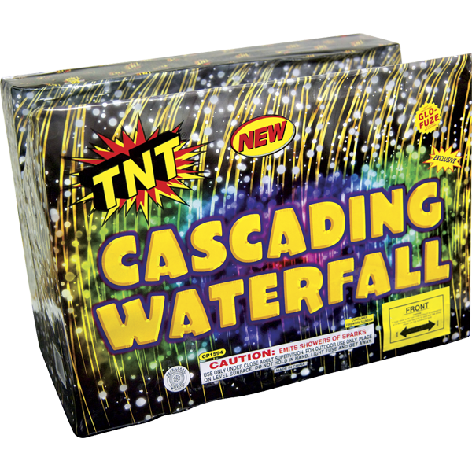
The Part That Cascades
What happens if you have CSS rules that conflict?
ul#catFacts li { margin-bottom: 4px; border: 1px solid brown; }
#nine { border: 3px solid green; }
The most specific selector gets chosen. The rules are pretty simple:
The # selector is more specific than ordinary element selectors.
Selectors that involve operators are more specific than selectors that do not.
Selectors lower on the page win ties with selectors higher on the page.

Slide 13
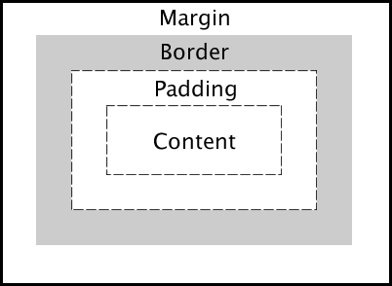
The CSS Box Model
HTML elements are boxes. The box takes up space.
We can customize the size and positioning of our boxes using the width, height, margin, border, and padding properties.
.tall { margin-top: 300px; border: 5px solid brown; padding: 20px; }
Investigate your boxes in the browser debugger! (right click -> inspect element)

Slide 14
Inline vs. Block vs. Inline-Block
Display Type | inline | block | inline-block
Description | Shows up inline with text. | Shows up on its own line and consumes full width of parent by default. | Shows up inline with text.
Properties | No width or height. Allows left & right margins/padding. | Really wide! Allows width/height, margin and padding everywhere. | Respects all properties.
Example Elements | <a> <span> | <h1> <p> <div> | Whatever you can imagine. <img> sort of.

Slide 15
Your Future Best Friends
<div>
is a generic block element that has no default style
<span>
is a generic inline element that has no default style
Although you won't necessarily need them for CAT PICTURE CENTRAL, they're nice to have when you need a "meaningless" element.

Slide 16

CSS Media Queries (Finally!)
Media Queries allow specific CSS statements to target a specific output device. They're like selectors from a higher dimension.
Here's a small sample:
@media (max-width: 400px) { h1 { font-size: 24px; } }
Cooper learning about CSS media queries

Slide 17
Making Use of Media Queries
The and operator lets you require multiple queries:
@media tv and (min-width: 1920px) { h1 { font-size: 24px; } }
Commas act as the or operator:
@media projection, 3d-glasses { .3d { color: red; text-shadow: 2px 2px blue; } }
The most useful media query is arguably max-width:
h1 { font-size: 64px; }
@media (max-width: 600px) { h1 { font-size: 24px; } }
@media (max-width: 400px) { h1 { font-size: 16px; } }

Slide 18
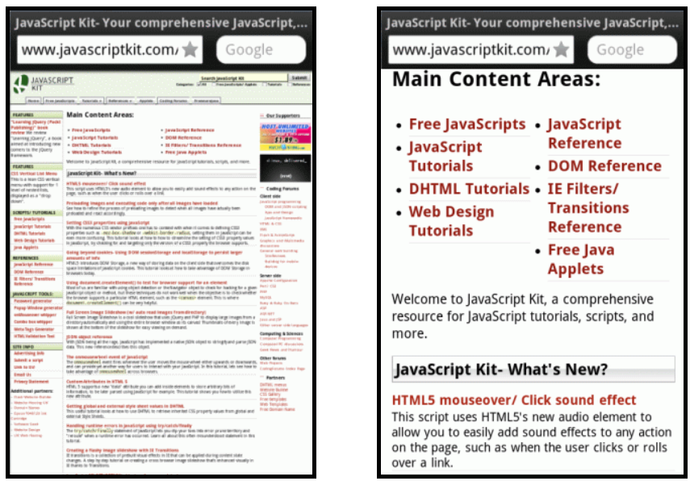
One Last Thing
Although a desktop browser won't have problems interpreting media queries, mobile browsers like to do their own thing. Use the following tag to force them into submission:
<meta name="viewport" content="width=device-width, initial-scale=1">

Slide 19
Your Mission
The owners of CAT PICTURE CENTRAL wants you to fix up their website. They'll pay you a box of kittens if you can meet the following requirements:
There should be no inline CSS on the page.
The font should be sans serif everywhere.
All cat pictures should be centered on their own line.
The navigation "bar" should be on a single line on desktop.
The website should look good on mobile.
Download the website code here: https://github.com/utcsmad/s16-web

Slide 20
Thanks for coming!
Please fill out the following anonymous exit survey:
http://tinyurl.com/gq39o7x

